Slide 1
Introduction into Wavelet Analysis
An practical guide to analyze preprocessed univariate time series
Michael C. Thrun

Slide 2
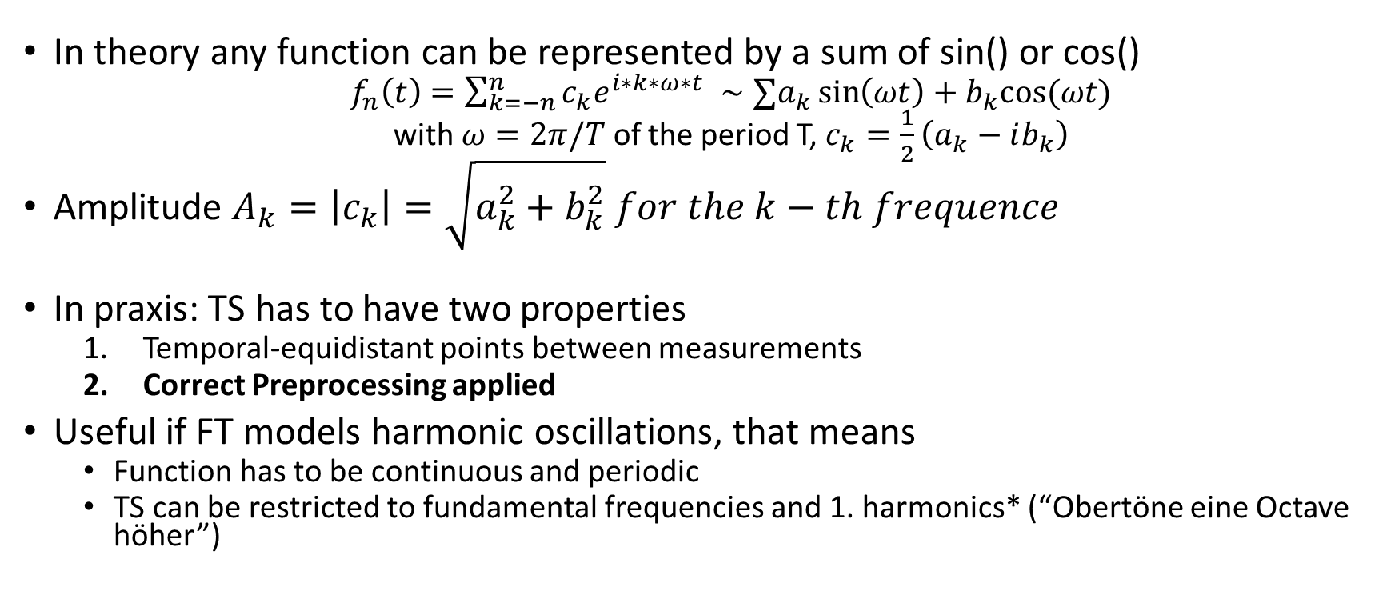
Some time series (TS) can be seen as periodic functions
In theory any function can be represented by a sum of sin() or cos()
$f_{n}\left(t\right)=\sum_{k=−n}^{n}{c_{k}e^{i∗k∗ω∗t} }∼{∑a}_{k}\sin\left(ωt\right)+b_{k}cos⁡(ωt)$
with $ω=2π/T$ of the period T, $c_{k}=\frac{1}{2}\left(a_{k}−ib_{k}\right)$
Amplitude $A_{k}=\left|c_{k}\right|=\sqrt{a_{k}^{2}+b_{k}^{2}} for the k−th frequence$
In praxis: TS has to have two properties
Temporal-equidistant points between measurements
Correct Preprocessing applied
Useful if FT models harmonic oscillations, that means
Function has to be continuous and periodic
TS can be restricted to fundamental frequencies and 1. harmonics* (“Obertöne eine Octave höher”)
*Proof: see Ultsch, Lectures about temporal Data Mining, 2015

Slide 3
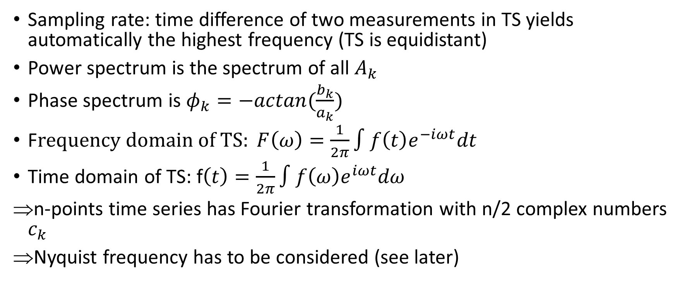
Recapitulation – Fourier Analysis
Sampling rate: time difference of two measurements in TS yields automatically the highest frequency (TS is equidistant)
Power spectrum is the spectrum of all $A_{k}$
Phase spectrum is $φ_{k}=−actan(\frac{b_{k}}{a_{k}})$
F$requency domain of TS: F\left(ω\right)=\frac{1}{2π}∫f\left(t\right)e^{−iωt}dt$
Time domain of TS: f$\left(t\right)=\frac{1}{2π}∫f\left(ω\right)e^{iωt}dω$
n-points time series has Fourier transformation with n/2 complex numbers $c_{k}$
Nyquist frequency has to be considered (see later)

Slide 4
Example
Depending on model assumption, e.g. (1)
Low pass: high frequencies are suppressed (easiest example: moving average)
High pass: low frequencies are suppressed
Example: Assuming that in white noise all frequencies have same amplitudes (“low heights in power spectrum”)
=>Band pass: frequencies with low amplitudes filtered
Beware: in finite TS most often low frequencies have high amplitudes
In reality: Filtering is convolution (“Faltungssatz”), see (2)
Examples: 99FourierExamples.R
(1) Aubert, A. H., Thrun, M. C., Breuer, L., Ultsch, A.: Knowledge discovery from high-frequency stream nitrate concentrations: hydrology and biology contributions, Scientific Reports, Nature, Vol. 6(31536), pp. 1-8, 2016.
(2) Prof. A. Ultsch – Lectures about temporal Data Mining 2017

Slide 5
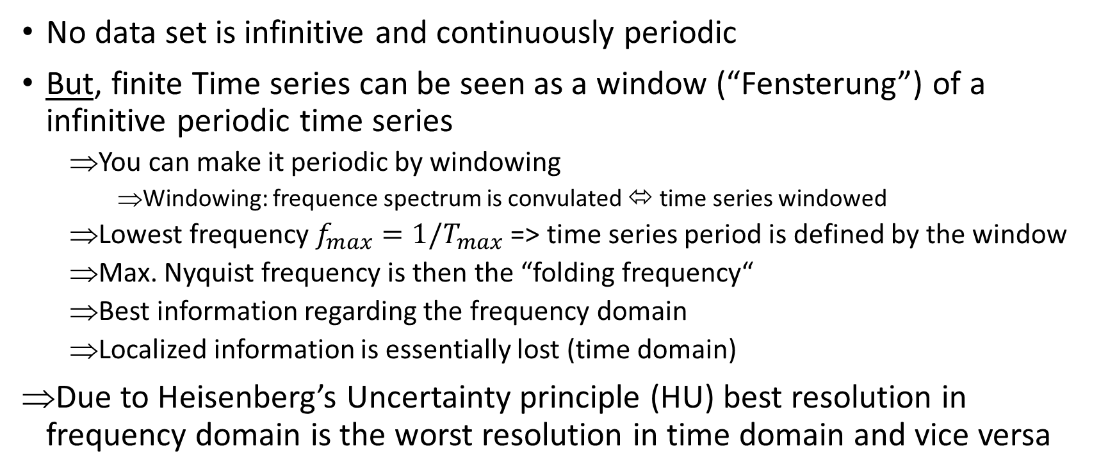
Problem FT
No data set is infinitive and continuously periodic
But, finite Time series can be seen as a window (“Fensterung”) of a infinitive periodic time series
You can make it periodic by windowing
Windowing: frequence spectrum is convulated ⬄ time series windowed
Lowest frequency $f_{max}=1/T_{max}$=> time series period is defined by the window
Max. Nyquist frequency is then the “folding frequency“
Best information regarding the frequency domain
Localized information is essentially lost (time domain)
Due to Heisenberg’s Uncertainty principle (HU) best resolution in frequency domain is the worst resolution in time domain and vice versa
Notes:
Faltungssatz

Slide 6
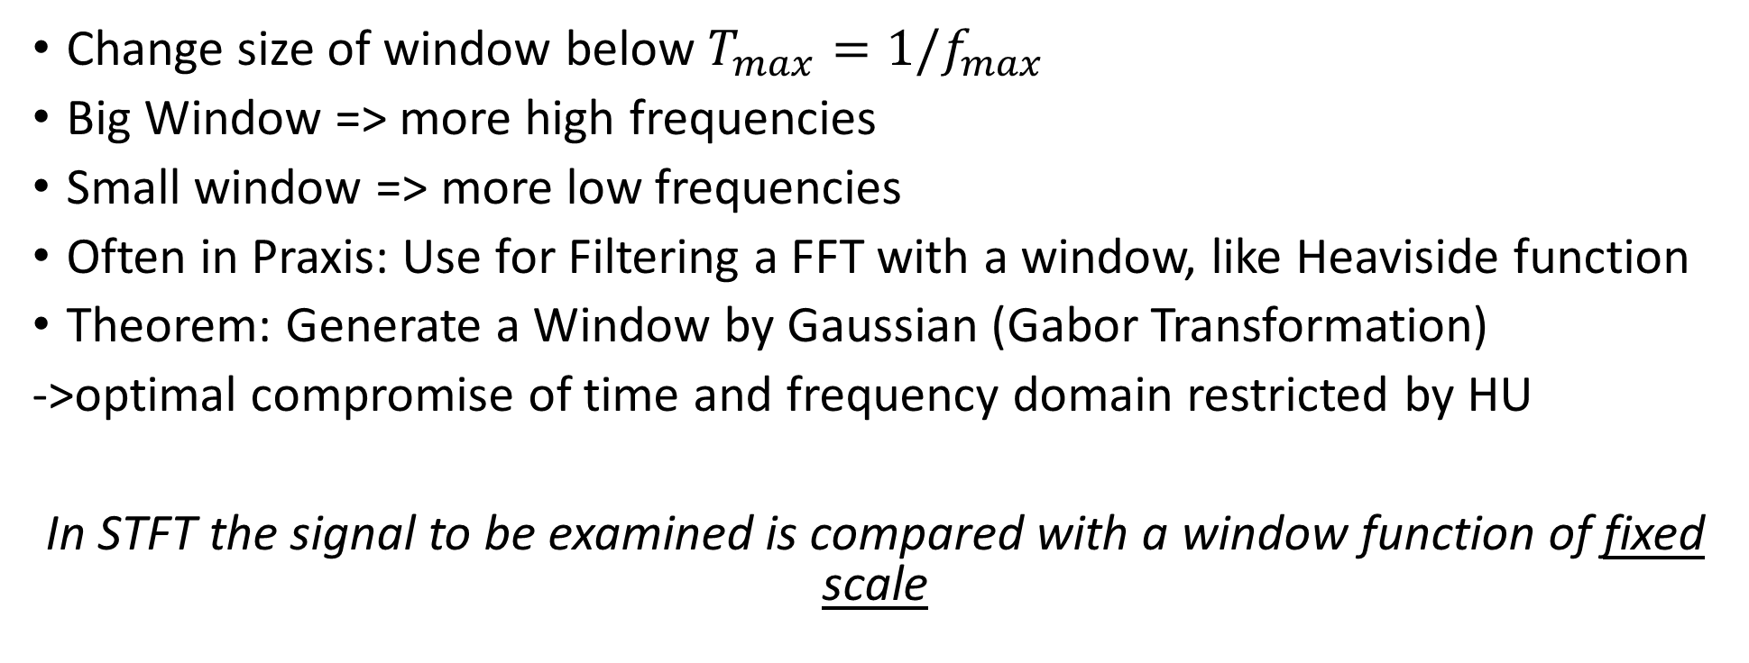
Short-Time Fourier Transformation (STFT)
Change size of window below $T_{max}=1/f_{max}$
Big Window => more high frequencies
Small window => more low frequencies
Often in Praxis: Use for Filtering a FFT with a window, like Heaviside function
Theorem: Generate a Window by Gaussian (Gabor Transformation)
->optimal compromise of time and frequency domain restricted by HU
In STFT the signal to be examined is compared with a window function of fixed scale

Slide 7
Motivation Wavelets Transformation (WT)
STFT moves and modulates the window (shift in the frequency domain)
Goal is to have…
at low frequencies a good frequency resolution at the expense of a poor time resolution
at high frequencies a good time resolution with poorer frequency resolution.
The short-time Fourier transform does not do this because of fixed window size
=> WT shifts and scales the window.
The scaling results in a frequency shift, as is the case with the modulation, but the time duration ("width" in the time domain) of the window is simultaneously reduced with a frequency increase.
This results in
A better temporal resolution at higher frequencies
At low frequencies the frequency resolution gets better, but the time resolution gets worse

Slide 8
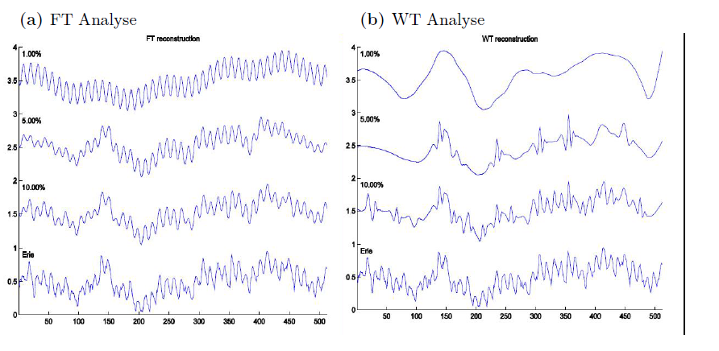
Conclusion
FT for practical purposes:
Use FT for seasonal components (2)
inability to associate features in the frequency domain with their location in time (1)
alteration in the frequency spectrum will result in changes throughout the time domain (1)
Use WT to examine global trend or filter non periodic noise (2)
ideal tool for analyzing signals of a non-stationary nature
irregular shape of wavelets lends them to analyzing signals with discontinuity's or sharp changes (1)
while their compactly supported nature enables temporal localization of a signals features (1)
Why not moving average instead of WT?
Because you would loose the exact
time domain, because the mean is calculated after the measurement regarding a time
-> “TS would be moved to the right”
(2) M.C. Thrun, Skript über temporales data mining, (1) http://www.wavelet.org/tutorial/wbasic

Slide 9
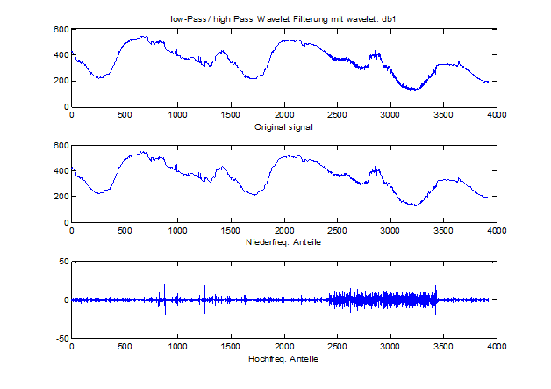
Appendix: Diskrete WT (DWT)
Siehe
Prof. A. Ultsch – Lectures about temporal Data Mining 2017, LowPassHighPassWaveletFilterung.m

Slide 10
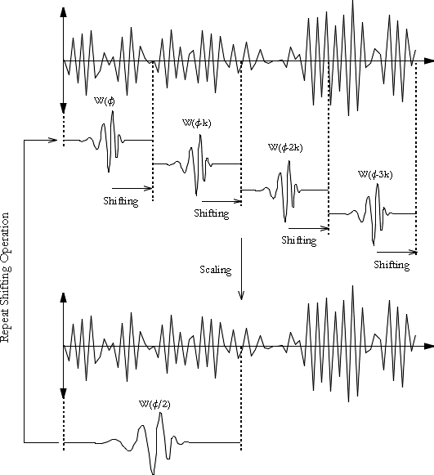
Scaling and shifting of a Daubechies Wavelets for the fitting of a time series, see (1)
(1) http://www.wavelet.org/tutorial/wbasic

Slide 11
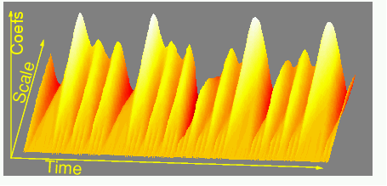
Anschauliche Bildung der Wavelet Transformation
3D Darstellung der Koeffizienten
Prof. A. Ultsch – Lectures about temporal Data Mining 2017

